Slide 1
VTP Series Long Shaft Vertical Drainage Pump
2023
International Pumping System.
Dedicated to the Human Fluid Handling Industry

Slide 2
1
Introduction
2
Products description
c o n t e n t
3
Product features and core
technology
4
Product sample project

Slide 3
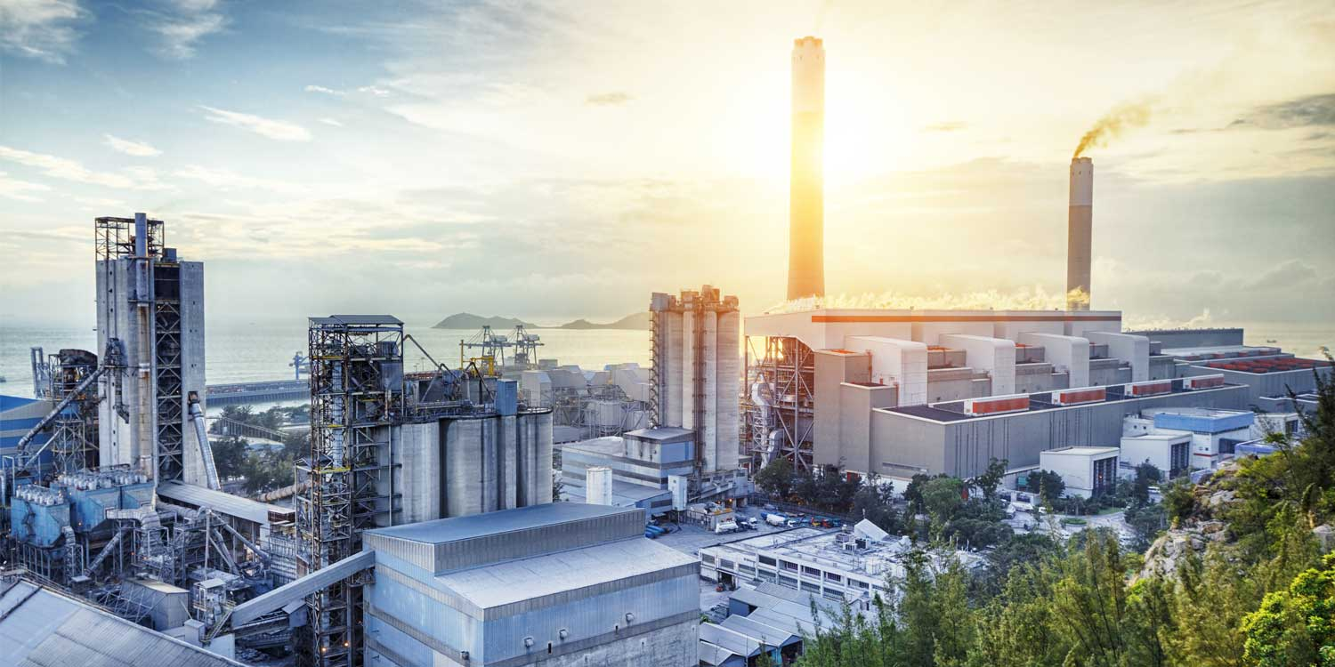
About the Company
01

Slide 4
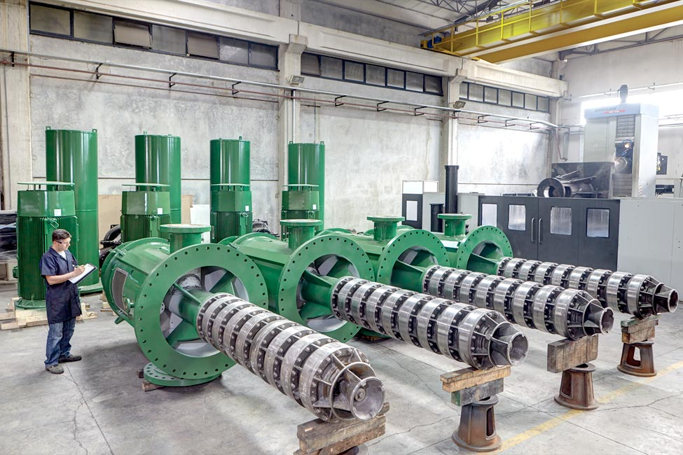
Company Profile
About us
International Pumping System (IPS) with a team of experts from France,Italy,Turkey,India and China is always looking for the best solution in the field of pumping.
IPS with the pioneering mission and responsibility of connecting with the first- class pioneer pump manufacturers in Turkey, India and China to produce quality pump to meet the maximum market demand.
We focus in 3 main segma :
Water Mangement (Water & waste water and flooded control)
Industrials (on shore & off shore, power plant,mining,process & chemical…)
Building service (building office,hospital, airports…)
Masflo pump brand is more and more widely used in large projects.
Factory in Turkey
Checking vertical turbine pumps before delivery to customers

Slide 5
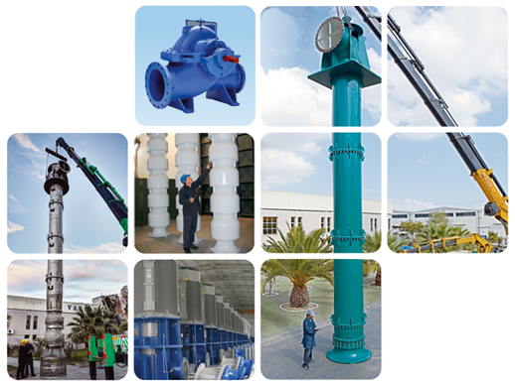
Partner in China and Turkey
The partner in China and Turkey has a national " level 1 " water pump test center, three-coordinate measuring instrument, dynamic and static balance measuring instrument, laser rapid prototyping instrument, multi-functional shot blasting machine, automatic argon arc Welding machines , large vertical lathes, large grinding machines, CNC machine tool clusters and other advanced 2,000 sets of production and testing equipment . There are more than 3,000 employees , colleges and technical secondary schools
Students accounted for 72.6% , including 475 with intermediate professional titles , 78 with senior professional titles , and 78 with national professional titles.
19 family experts and 6 professors. Every year, a large amount of money is invested in technology
Technological innovation, product development and equipment introduction, holding national patent technology nearly
More than 600 items, participating in the drafting of a large number of
national and industry standards every year and writing work, involving water conservancy, chemical industry, fire protection, urban water supply, etc.
There are dozens of product and technical standards in various fields. Group building
There is a complete sales service network, with more than 30 branches
and
200 branches, with a professional team of more than 1,800 people Professional sales and service team, to provide customers with professional Technical support and excellent marketing services.
Group headquarters: Fengbang Industrial
Pca orvekring an area of 88,000 ㎡, it is a center for management, marketing, production and R&D.
Strong manufacturing strength and service capabilities

Slide 6
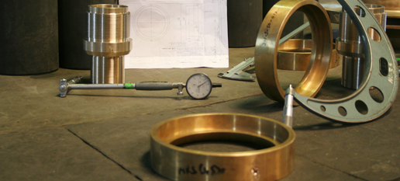
VTP long shaft vertical drainage pump
Supplier quality standard specifies certain management system
requirements for use in the supplier’s shop and an assuarance of
qulity and continued improvemenf in the supplier’s performance.
Our standard process to develop the necessary comptetence and to
meet the specific quality requirement of our products at the supplier’s end.
Assessment
Training
Performance monitoring
Process upgradation and avoidance of mistakes by operators
Value Engineering
QMS certification
Manufacturing Excellence
Supplier Quality Management
.

Slide 7
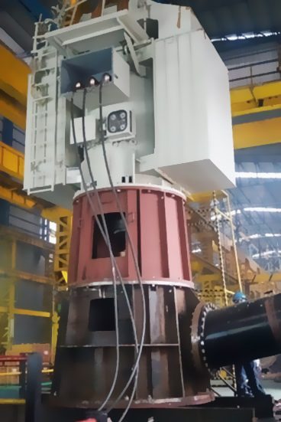
VTP long shaft vertical drainage pump
Facilities, Test Bed
Respond to the call to join the hydraulic industry
Largest test bed in India
Vertical turbine pump testing capacity upto 70.000m3/h and motor rating upto 6.000Kw in
11Kv, 6,6Kv, 3,3Kv configuration
Horizontal pump testing upto 25.000m3/h and motor upto 6.000Kw in 11Kv, 6,6Kv, 3,3Kv
2nd test bed can test pumps with job motor up to 2000Kw of 11Kv, 6,6Kv, 3,3Kv.
7 others test beds for internal & external inspection.
Have soft starters for starting motors up to 5.000Kw.
Crane up to 60 tons.
Computerized test bed for directly acquiring reading.
Head measurement up to 400m through pressure gauge
Manometers used for measuring suction side pressure
Non-contact techno meters for speed measuring
Noise and vibration (velocity, displacement) measurement.
NPSHR test in all horizontal pump.

Slide 8
VTP long shaft vertical drainage pump
The regards "committed to the human fluid treatment industry and building an international fluid industry brand" as the core concept of the company, among which "committed to the human fluid treatment industry" is the company's mission, and "building an international fluid industry brand" is the company's vision. We will always insist on forging ahead in the field of fluid industry, seek welfare for the survival and development of all mankind, and at the same time actively build an international brand that goes to the world, and continue to strive for the great mission of revitalizing the national industry.
We "management, always keep innovating; quality, always strictly control, keep improving; technology, independent innovation, forge ahead, guide the development direction of industry technology" as the enterprise spirit, which marks that deeply integrates the concept of innovation-driven development into the enterprise In operation management, a cultural atmosphere advocating innovation has been created to guide all employees to improve enterprise management efficiency through innovation, improve product and service quality through innovation, and lead the development of the entire industry through innovation.
We regards "unity and progress, realistic innovation, win-win cooperation" as the core value of the enterprise, which indicates that regards harmonious labor relations as the foundation of enterprise survival, innovation and progress as the methodology of enterprise growth, and win-win cooperation as the As the ultimate goal of enterprise development, so as to realize the interdependence, mutual benefit and win-win among employees, enterprises and value chains.
Focus on social responsibility and advocate a win-win situation for enterprises
Factory in China

Slide 9
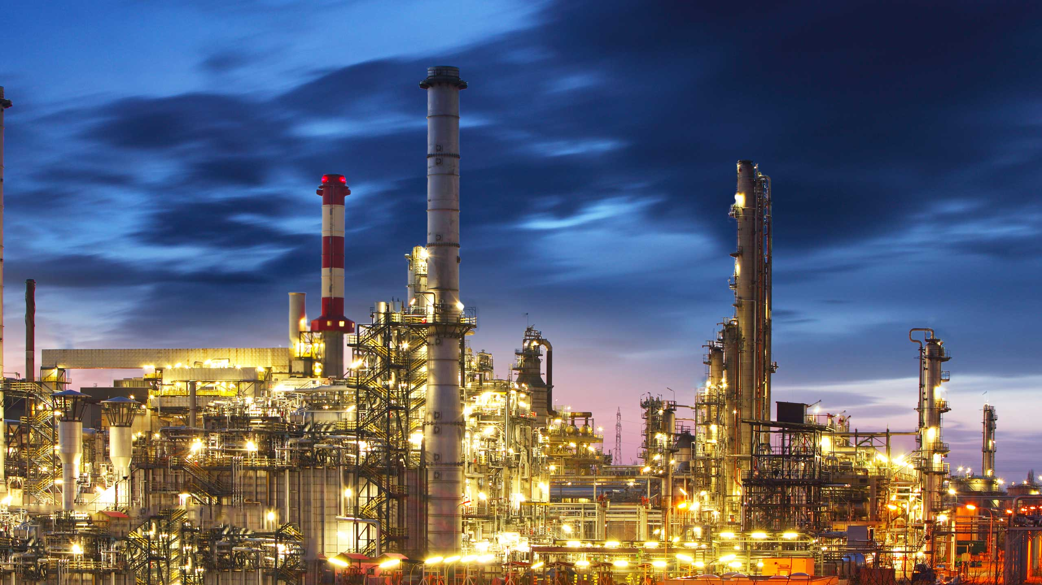
P r o d u c t
D e s c r i p t i o n
02

Slide 10
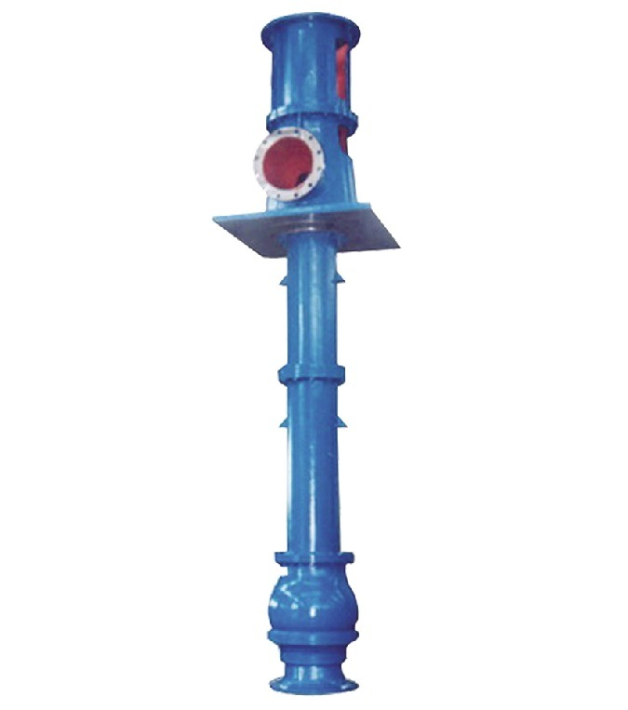
VTP Long Shaft Vertical Drainage Pump
The VTP long-axis vertical drainage pump produced by our company is a comprehensive long-axis deep well centrifugal pump, power plant circulating oblique flow pump, and a product independently developed in combination with the company's existing products and market requirements. It has high efficiency, wide range of high efficiency, and stable performance. , Good anti-cavitation performance and so on.
Conditions and occasions of use
Generally, the temperature of the medium does not exceed 60°C , the pH value is within the range of 6.5-­‐8.5 , and the suspended maGer contained in the medium is less than 150mg/L . The VTP type pump is based on the LP type, adding shaM protec-on The bushing lubricates the water guide bearing through external clean water. It can transport the medium containing solid par-cles with a maximum diameter of 2mm and a content of less than 2g/L . VTP pumps must be connected with clean water to lubricate the rubber bearings before star-ng. If there are special condi-ons of use, the contract or technical agreement shall prevail;
VTP long axis vertical drainage pump is mainly used in municipal engineering, metallurgical
iron and steel, mining, chemical papermaking, tap water, power plants and farmland water conservancy projects, etc.

Slide 11
VTP Long Shaft Vertical Drainage Pump
2. Structural characteris-cs of VTP long-axis vertical drainage pump
It is mainly installed on a single founda-on, and can also be made into a double founda-on installa-on structure according to site condi-ons
According to the head of the pump , the impeller has centrifugal type ( high head ) , mixed ﬂow type and axial ﬂow type ( low head )
Water outlet mode : upper outlet type and lower outlet type Sealing form: conven-onal packing seal ( mechanical seal )
Sleeve (must be used in conjunc-on with external ﬂushing water ) - to protect the shaft and guide bearing ( for medium with high impurity content or special working condi-ons, etc. )
Core pumps VTP type ( upper water outlet and lower water outlet ) , during maintenance , the pump foundation andpiping do not need to be disassembled, only the rotor part is pulled out .
The connec-on between the impeller shaft, drive shaft and motor shaft is connected by rigid coupling ( threaded coupling and sleeve coupling ) ; the coupling between the water pump and the motor is an elas-c cancella-on coupling, which can According to customer requirements, it is changed to a diaphragm coupling, etc.
The guide bearings are generally water-­‐lubricated rubber bearings, and can also be replaced with bearings of
other materials (polyurethane, Sairon and other materials) according to customer and site use condi-ons.
The motor generally adopts the standard Y series motor, and can also use the YLB type special motor and diesel engine according to the customer and site use conditions.

Slide 12
VTP Long Shaft Vertical Drainage Pump
Structural of VTP vertical axis drainage pump
It is mainly installed on a single founda-on, and can also be made into a double founda-on installa-on structure according to site condi-ons
According to the head of the pump , the impeller has centrifugal type ( high head ) , mixed ﬂow type and axial ﬂow type ( low head )
Water outlet mode : upper outlet type and lower outlet type; outlet diameter
Sleeve (must be used in conjunction with external ﬂushing water ) - to protect the shaM and guide bearing ( for medium with high impurity content or special working condi-ons, etc. )
Heart pumping type (upper water outlet and lower water outlet) : During maintenance , the pump founda-on and piping do not need to be disassembled, only the rotor part is drawn out .
The connec-on between impeller shaft, drive shaM and motor shaft is connected by rigid
coupling ( threaded coupling and sleeve coupling )
The guide bearings are generally water-­‐lubricated rubber bearings, and can also be replaced with bearings of other materials (polyurethane, Sairon and other materials) according to customer and site use condi-ons.
The motor generally adopts the standard Y series motor, and can also use the YLB type
special motor with a corner gearbox and a diesel engine according to the customer and site use conditions .

Slide 13
VTP Long Shaft Vertical Drainage Pump
It is mainly installed on a single founda-on, and can also be made into a double founda-on installa-on structure according to site condi-ons
According to the head of the pump , the impeller has centrifugal type ( high head ) , mixed ﬂow type and axial ﬂow type ( low head )
Water outlet mode : upper outlet type and lower outlet type
Sleeve (must be used in conjunc-on with external ﬂushing water ) - to protect the shaM and guide bearing ( for medium with high impurity content or special working condi-ons, etc. )
Heart pumping type (upper water outlet and lower water outlet) : During maintenance , the pump founda-on and piping do not need to be disassembled, only the rotor part is drawn out .
The connec-on between impeller shaft, drive shaft and motor shaft is connected by rigid
coupling ( threaded coupling and sleeve coupling )
The guide bearings are generally water-­‐lubricated rubber bearings, and can also be replaced with bearings of other materials (polyurethane, Sairon and other materials) according to customer and site use condi-ons.
The motor generally adopts the standard Y series motor, and can also use the YLB type
special motor with a corner gearbox and a diesel engine according to the customer and site use conditions .

Slide 14
VTP Long Shaft Vertical Drainage Pump
3. Implementa-on standards
GB/T5657 Centrifugal pump technical condi-ons ...Ⅲ .
JB/T443 Long shaft centrifugal deep well pump technical conditions.
GB/T13008 technical condi-ons for mixed ﬂow pumps and axial ﬂow pumps.

Slide 15
VTP Long Shaft Vertical Drainage Pump
Structural diagram of the water outlet sec-on on the pump body

Slide 16
VTP Long Shaft Vertical Drainage Pump
Core Pulling Struct ure
( Water pump bears axial force )
( upper
water )

Slide 17
VTP long shaft vertical drainage pump
Sectional view of the core-pulling structure ( the motor bears axial force ) ( water outlet from the bottom )

Slide 18
VTP long shaft vertical drainage pump
Sec-onal structure diagram of transmission parts

Slide 19
VTP Long Shaft Vertical Drainage Pump
Installation diagram one with diesel engine installation drawing

Slide 20
VTP long shaft vertical drainage pump
Installation diagram two Distribution motor installation drawing
( upper outlet structure )
Installation picture three Distribution motor installation drawing
( bottom outlet structure )

Slide 21
VTP long shaft vertical drainage pump
Material of main parts
Conven-onal supply: horn, impeller, bracket, guide vane body: HT200 Water outlet seat, water pipe, bracket ( part ) , motor seat: Q235 Pump shaM: drive shaM: 45# steel
Water guide bearing: HT200+ industrial rubber
ShaM seal: oil impregnated graphite packing, carbon ﬁber
Op-onal supply: impeller: bronze, stainless steel, etc. Wet parts: stainless steel, duc-le iron
Pump shaM: 20CR13 , 40CR , stainless steel, etc.
Water guide bearing: HT200/ ZG270/ stainless steel / + industrial rubber / polyurethane rubber / Canada Sailong
The user proposes other materials for pump parts, which will be agreed at that -me
Note: All materials of the pump body can be customized according to customer requirements

Slide 22
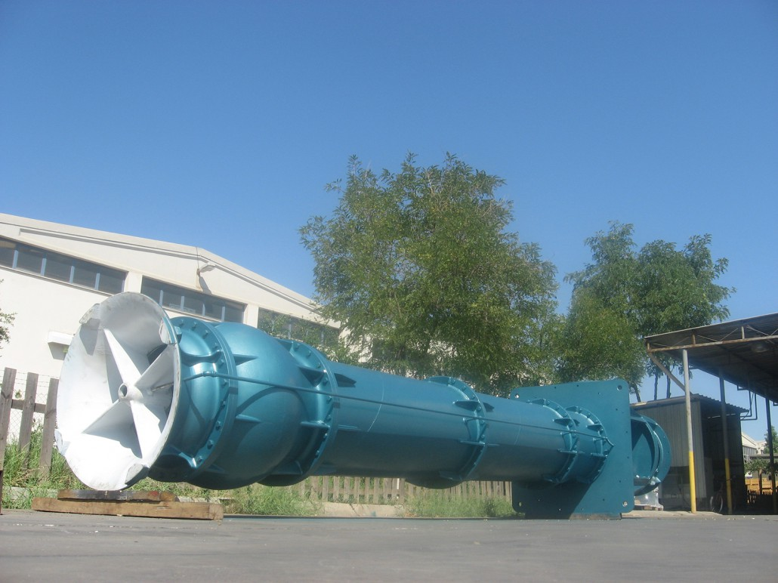
P r o d u c t F e a t u r e s
a n d C o r e
Te c h n o l o g y
03

Slide 23
VTP long shaft vertical drainage pump
Features
The entire series has a wide range of models, complete models and calibers and specifications, and the distribution of varieties is even and reasonable. Others that are not within the scope of the spectrum can be redesigned and developed according to customer parameters.
The water pump has excellent hydraulic performance and high efficiency.
Equipped with a general-purpose motor, it is economical, easy and convenient to maintain, and has no hidden danger of submersible motor entering water, which is safe and reliable.
Equipped with a general-purpose diesel engine and a corner gearbox to meet the needs of on-site fire protection.

Slide 24
VTP long shaft vertical drainage pump
Product core technology
1. Eﬃcient hydraulic design and strength analysis design:
The ﬂow ﬁeld in the pump is op-mized by using an eﬃcient hydraulic model and advanced computa-onal ﬂuid dynamics software (CFD), and the high-­‐ eﬃciency working area of the pump is widened by adjus-ng the geometric parameters of the impeller and volute ( guide body ) , so that the pump can operate at a larger It can operate eﬃciently in the range of working condi-ons .
The strength analysis of the pump body, base and key stress-­‐bearing components is carried out through CFD to ensure the smooth and reliable opera-on of the pump.

Slide 25
VTP long shaft vertical drainage pump
CFD pump hydraulic analysis

Slide 26
VTP long shaft vertical drainage pump
CFD
water pump strength mechani cal analysis

Slide 27
VTP long shaft vertical drainage pump
Three-­‐dimensional drawing of diversion ﬂuid

Slide 28
VTP long shaft vertical drainage pump
3D drawing of impeller components (axial ﬂow pump blades)

Slide 29
VTP long shaft vertical drainage pump
3D drawing of impeller components (mixed ﬂow pump blades)

Slide 30
VTP long shaft vertical drainage pump
Reliable and op;mized structural design, etc.:
Shaft design: All shafts are designed as rigid shafts to prevent damage to the water pump caused by ; a shaft sleeve is added to the water guide bearing (the shaft sleeve is chrome-­‐plated to increase its wear resistance ) , to prevent wear on the pump shaft and save maintenance costs.
The design of the shaft coupling ( shaft to shaft connec-on ) : the improved sleeve coupling structure is adopted, the opera-on can be high, and the installa-on and disassembly are convenient.
For high tech water pumps, a packing shaft sleeve ( chrome-­‐plated on the shaft sleeve to increase its wear resistance ) and a pressure relief device are added to the packing seal to ensure the reliability of the packing seal and prolong its service life.
The water guide bearing adopts Sailong bearing (XXL) imported from Canada , which can withstand short-­‐term dry grinding and has a long service life.
The bearing inside the transmission body adopts self-aligning bearing, which can compensate the dimensional error caused by processing, further prevent the eccentric wear of the water guide
bearing, and prolong the service life of the water guide bearing. The transmission body is also provided with a water pump device to prevent the pump from being damaged by the live when the water pump is started instantly.

Slide 31
VTP long shaft vertical drainage pump
1. Shaft design: All shafts are designed as rigid shafts to prevent damage to the water pump due to soft shafts; a shaft sleeve is added to the water guide bearing (the shaft sleeve is chrome-­‐plated to increase its wear resistance ) , to prevent wear on the pump shaft and save maintenance costs.

Slide 32
VTP long shaft vertical drainage pump
2. The design of the shaft coupling ( shaft to shaft connec-on ) : the improved sleeve coupling structure is adopted, the opera-on can be high, and the installa-on and disassembly are convenient.
Sleeve Coupling Parts

Slide 33
VTP long shaft vertical drainage pump
3. For high-lift water pumps, a packing shaft sleeve ( chrome-plated on the shaft sleeve to increase its wear resistance ) and a pressure relief device are added to the packing seal to ensure the reliability of the packing seal and prolong its service life.
Packing parts structure diagram

Slide 34
VTP long shaft vertical drainage pump
4. The water guide bearing adopts Sailong bearing (XXL) imported from Canada , which can withstand short-­‐term dry grinding and has a long service life.
Water guide bearin g parts

Slide 35
VTP long shaft vertical drainage pump
5. The bearing inside the transmission body adopts the self-aligning bearing, which can compensate the dimensional error caused by processing, further prevent the eccentric wear of the water guide bearing, and prolong the service life of the water guide bearing. The transmission body is also provided with a water pump anti-lifting device to prevent the pump from being damaged by the lift when the water pump is started instantly.
transmission body parts

Slide 36
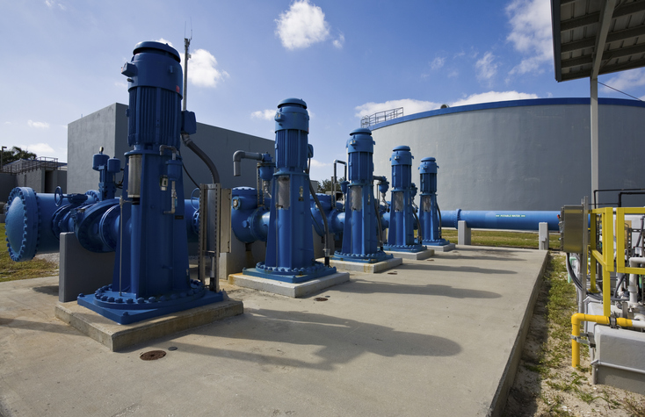
P r o d u c t
S a m p l e
P r o j e c t
04

Slide 37
VTP long shaft vertical drainage pump
Saudi arabia 1000VTP-50 installation at site

Slide 38
VTP long shaft vertical drainage pump
Kyrgyzstan
500VTP-100
350VTP-120

Slide 39
VTP long shaft vertical drainage pump
Iran IPMI project seawater lift pump
800VTP-140
at site

Slide 40
VTP long shaft vertical drainage pump
Iran IPMI project seawater lift pump 500VTP-140
factory site assembly
machine test

Slide 41
VTP long shaft vertical drainage pump
Floating boat Pumping Station
Model : 1600 VTP-10 in Shanghai

Slide 42
VTP long shaft vertical drainage pump
Assembled at factory 1600VTP-13

Slide 43
VTP long shaft vertical drainage pump
Sea water lift pump 500VTP-­‐ 80
Assembly
Beijing

Slide 44
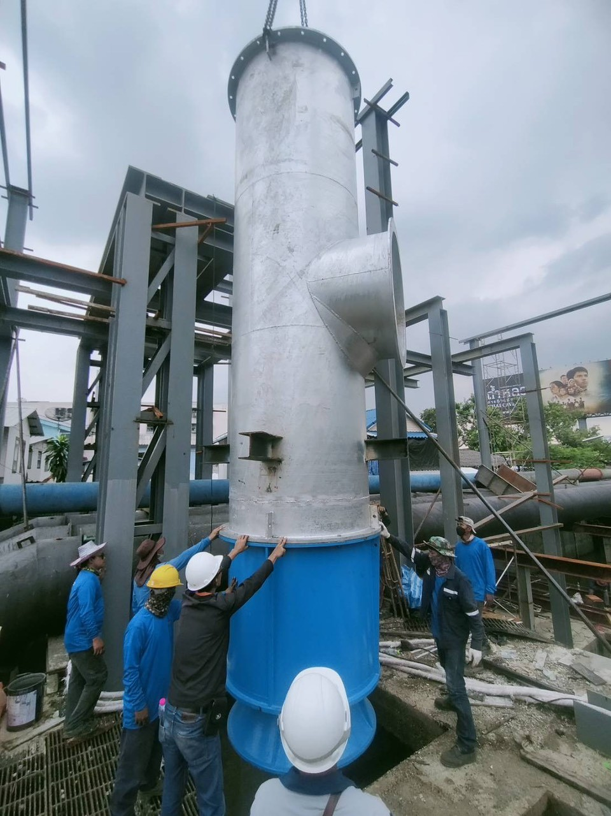
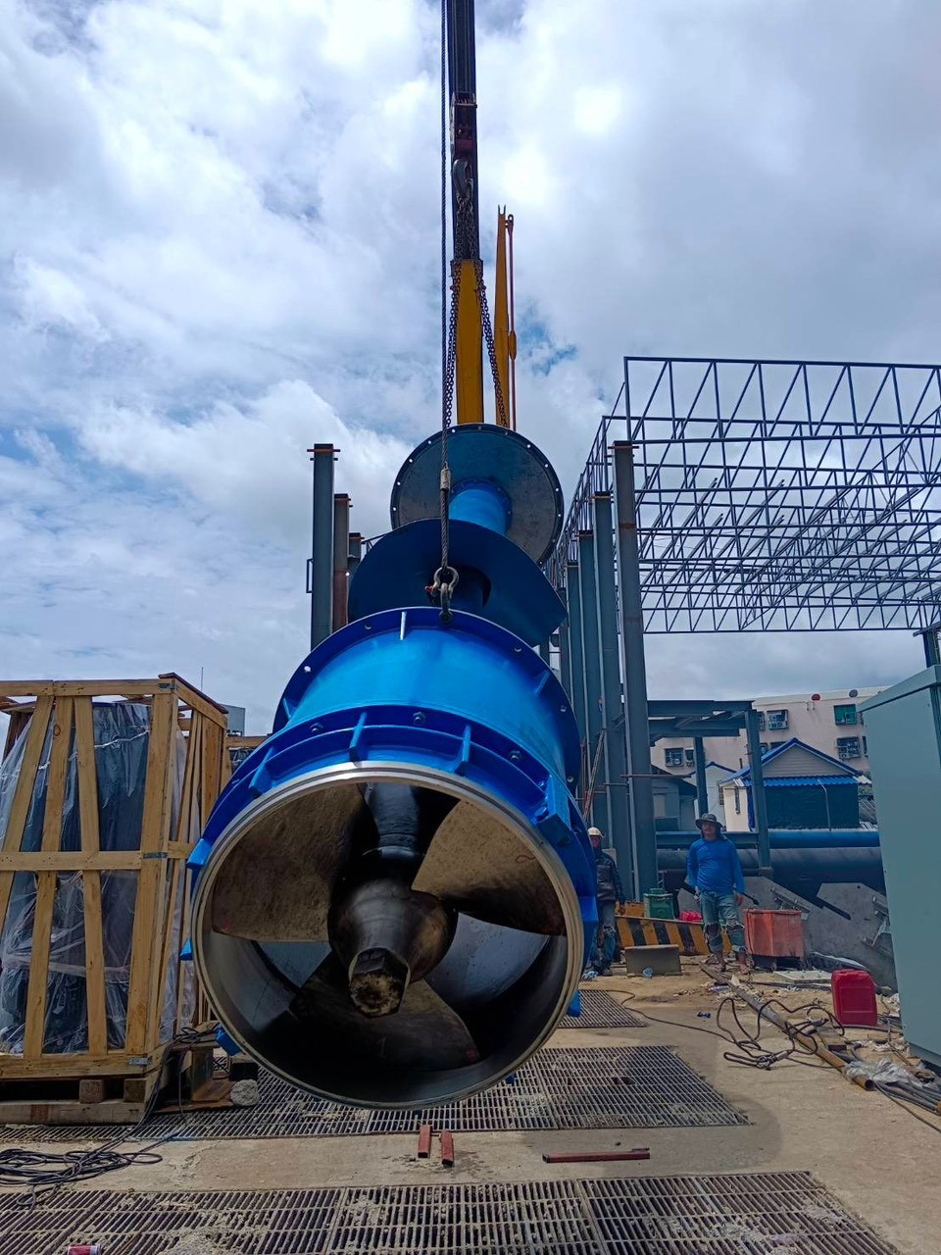
VTP long shaft vertical drainage pump
Flooded system
10 sets vertical
turbine pump
1200VTP-4
Rating 3m3/sec
Thailand

Slide 45
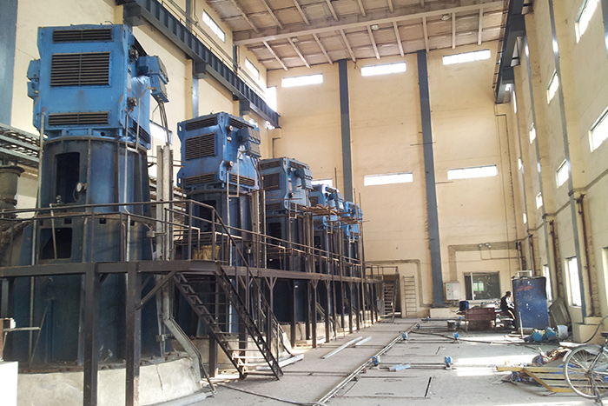
VTP long shaft vertical drainage pump
Flooded system
6 sets vertical
turbine pump
1600VTP-6
Rating 11m3/sec
Motor 11Kv
1400Kw
Yingde City
Guangzhou

Slide 46
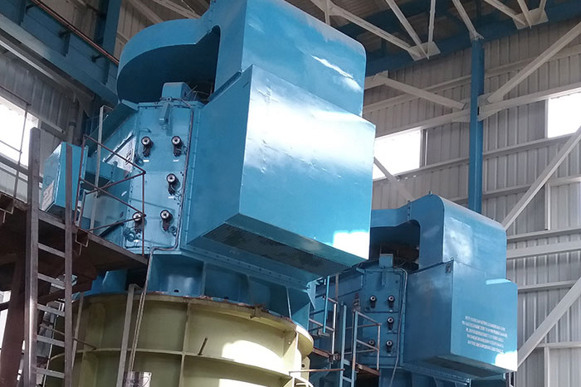
VTP long shaft vertical drainage pump
Flooded system
7 sets vertical
turbine pump
1700VTP-6
Rating 8,74m3/sec
Weinan Irrigation

Slide 47
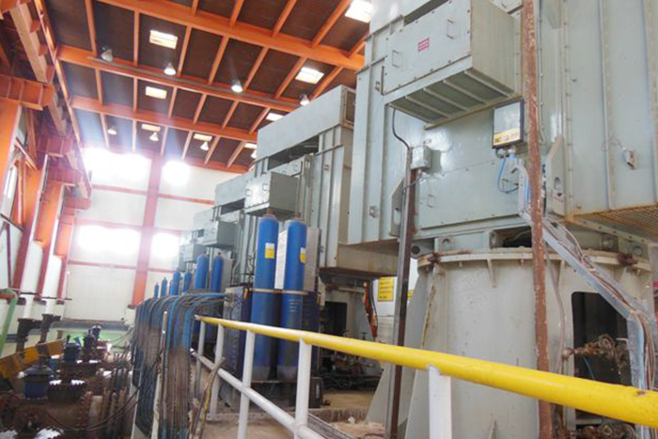
VTP long shaft vertical drainage pump
Flooded system
6 sets vertical
turbine pump
1600VTP-10
Rating 9,5m3/sec
Hunan Irrigation
Guangzhou

Slide 48
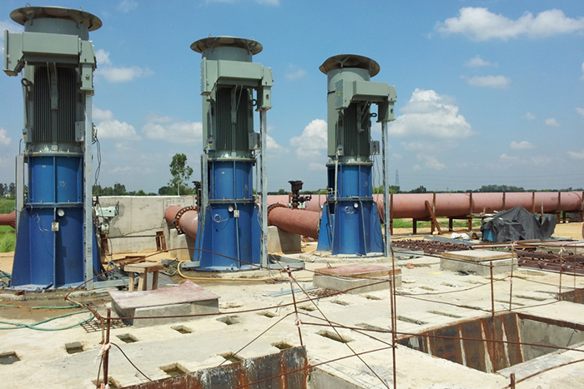
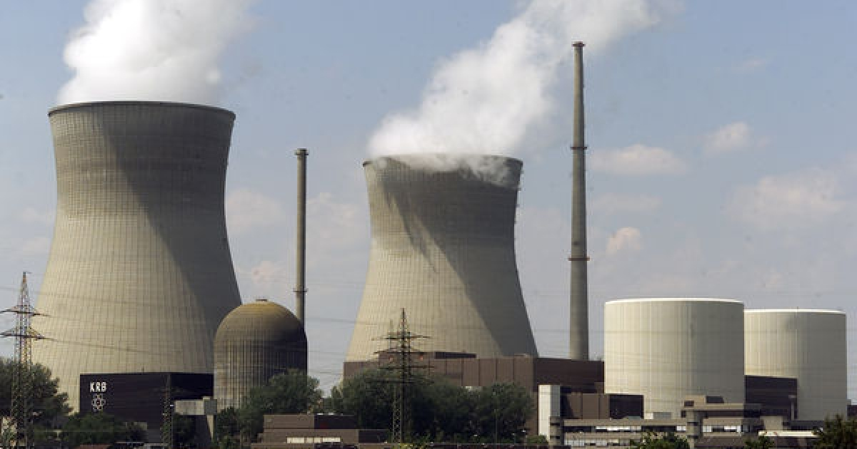
VTP long shaft vertical drainage pump
Guangdong power plant 4 set vertical turbine pump Model 2000VTP-7
Rating : 21m3/sec motor 11Kv, 2400Kw

Slide 49
VTP long shaft vertical drainage pump
Diesel engine-driven seawater long-axis fire pump ( flow rate : Q=230L/s , head: H=195m) preliminary design scheme:
The water pump model is tentatively determined to be 400 VTP-195 :
1. The single -stage head is 39 meters, and there are 5 impellers in total ( the number of pump impeller stages can be determined according to the respective manufacturers ) , the speed is 1500r/min , and the specific speed is Ns= 168.2 , NPSHr = 6 , pump efficiency 80% , matching diesel engine power 808KW ( gearbox input 1800 rpm, output 1500 rpm ) or diesel engine power 880KW .
2. Selection of caliber: When 350 caliber is used, the maximum flow velocity under the rated flow rate in the pump lift pipe is 4.36m/s , and 2.8m/s when 400 caliber is used, and 400 caliber is selected after comprehensive consideration .
3. Selection of materials: Duplex stainless steel is selected for the flow-through parts of the water pump, and Sailong bearings imported from Canada or Guangzhou Yanlong bearings are selected for water guide bearings ( or customized by customers ) .
4. For the selection of casing, considering that the crystallization of seawater will wear the water guide bearing of the pump, it is recommended to install an external clean water flushing ( in order to flush the remaining seawater after the pump is used )
The submerged length and installation method are determined by the customer's site ( the maximum length of a single piece can be determined according to the site conditions ) .

Slide 50
VTP long shaft vertical drainage pump
Circulating water pump ( flow rate : Q=9444L/s , head: H=30m) preliminary design scheme:
The water pump model is tentatively determined to be 2400 VTP-30 :
1. Considering the convenience of on-site maintenance, the core-pulling structure is specially selected; the speed is 370r/min , and the specific speed is Ns= 323.8 , NPSHr =9.3m , pump efficiency is 87% , supporting motor power is 3700KW .
2. Selection of caliber: Considering the core pulling of the rotor, the caliber is 2400mm .
3. Selection of materials: Duplex stainless steel is selected for the flow-through parts of the water pump, and Sailong bearings imported from Canada or Guangzhou Yanlong bearings are selected for water guide bearings ( or customized by customers ) .
Note: The submerged length and installation method are determined by the customer's site ( the maximum length of a single piece can be determined by site conditions ) .
If the structure model without core pulling is 1800 VTP-30 , the speed, power and material are the same as above.

